Slide 1
Case Study EDA
Sid Swarupananda
Sean mcWhirter

Slide 2
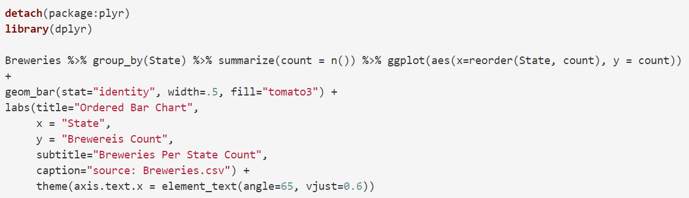
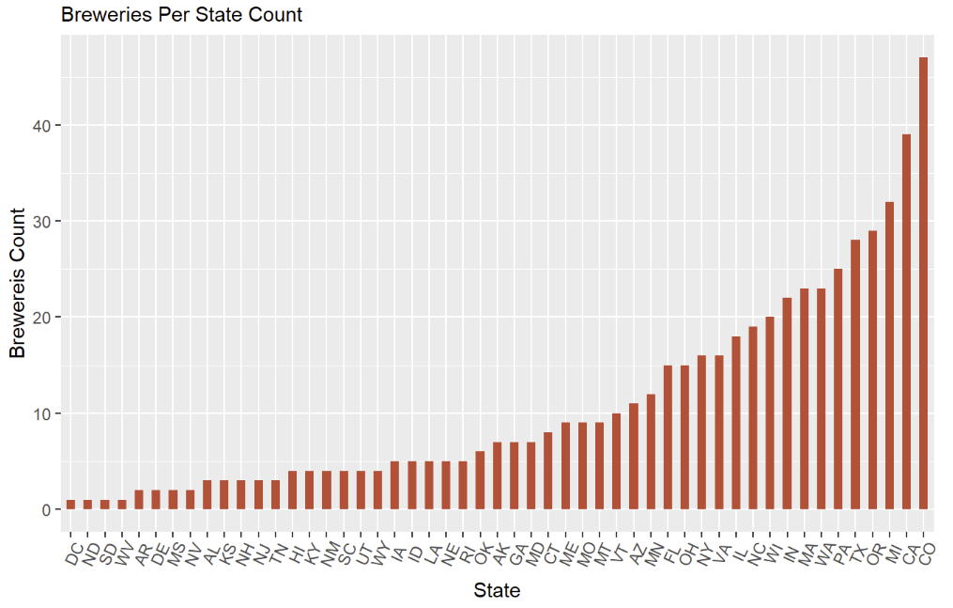
How many breweries are present in each state?

Slide 3
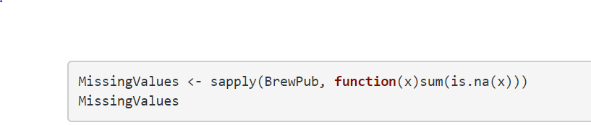
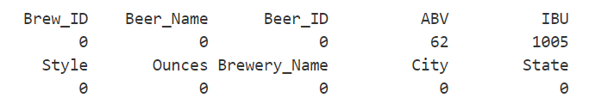
Address the missing values in each column
ABV and IBU are the only columns with missing values. However, since we have a high number of observations, we should be able to omit the missing values and still be able to determine any significant insights.

Slide 4
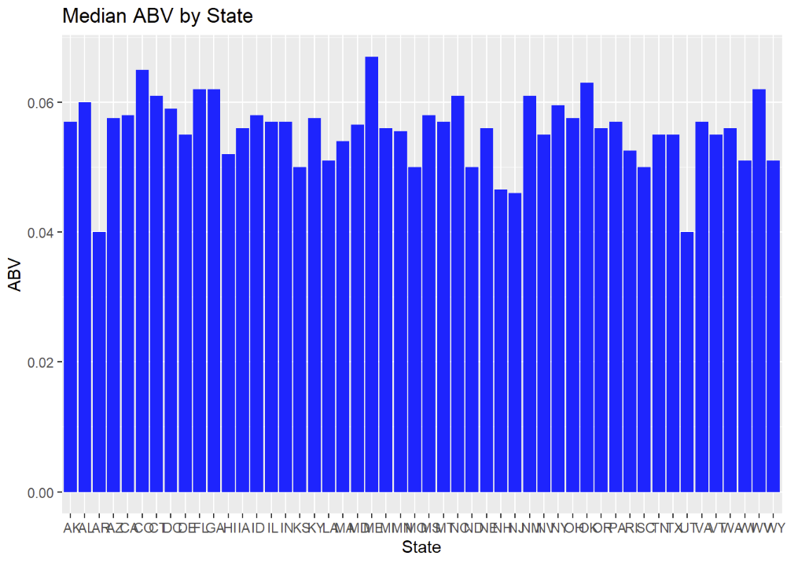
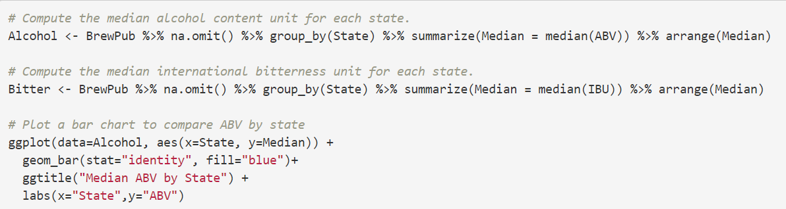
Compute the median alcohol content and international bitterness unit for each state. Plot a bar chart to compare

Slide 5
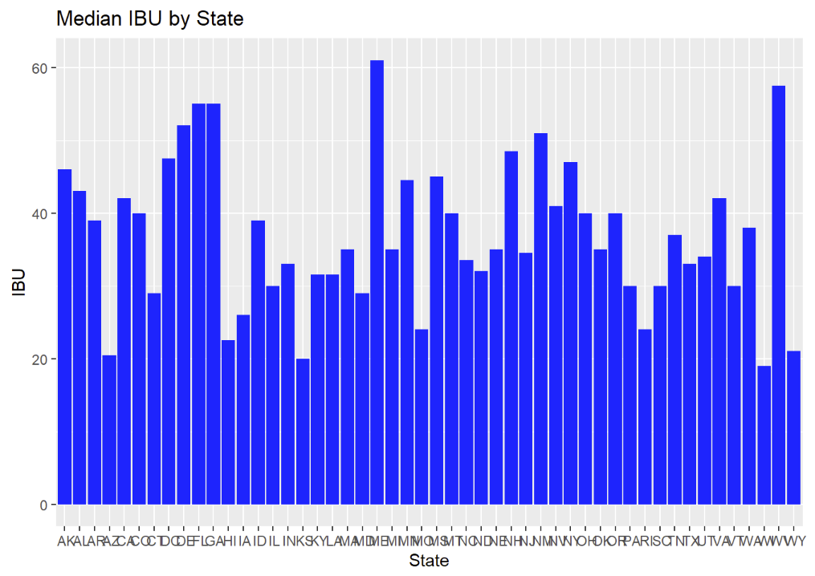
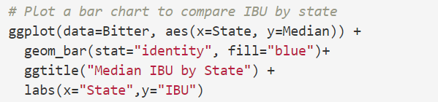
Median IBU by State

Slide 6
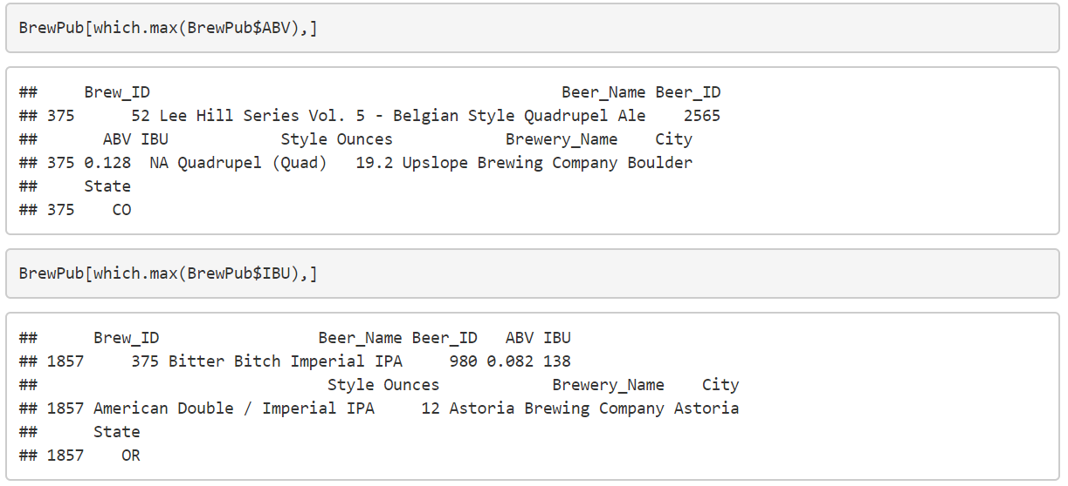
Which state has the maximum alcoholic (ABV) beer? Which state has the most bitter (IBU) beer?

Slide 7
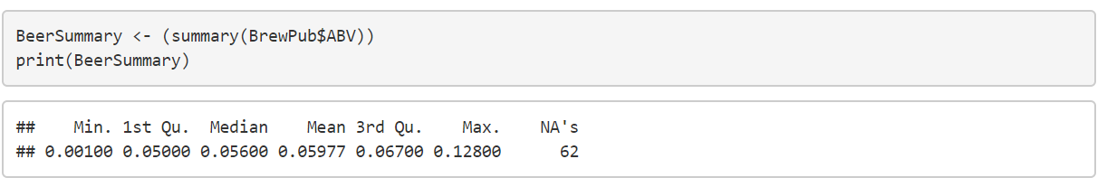
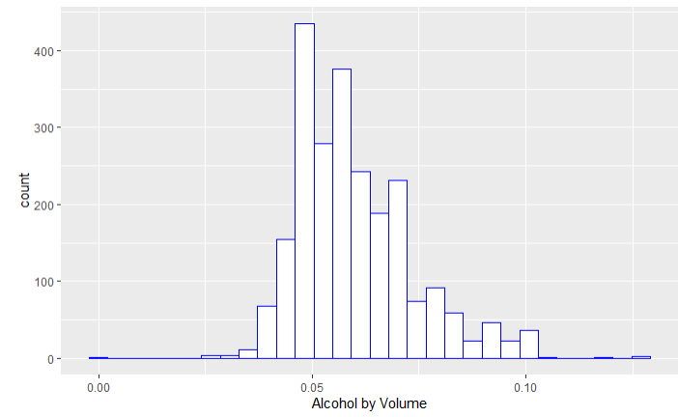
Comment on the summary statistics and distribution of the ABV variable
Looking at a histogram of the data, it seems to be a bit right-skewed. This makes sense because beer is not meant to be a very high ABV drink—the high ABV beers would be more rare.

Slide 8
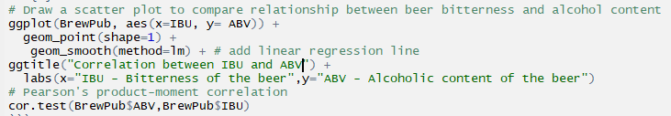
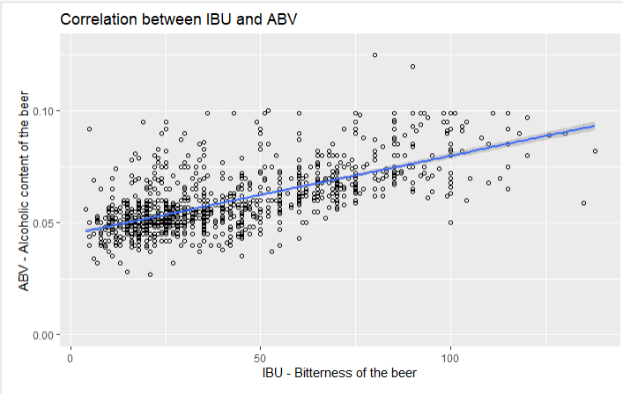
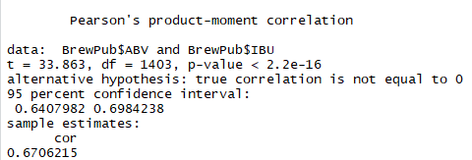
Is there an apparent relationship between the bitterness of the beer and its alcoholic content? Draw a scatter plot.

Slide 9
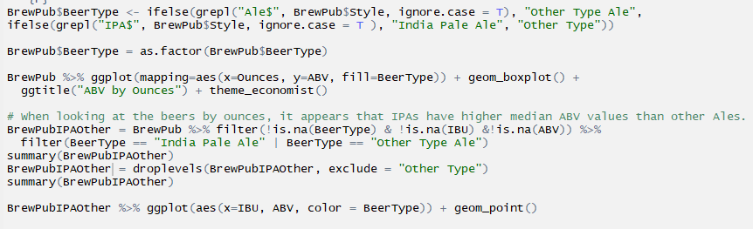
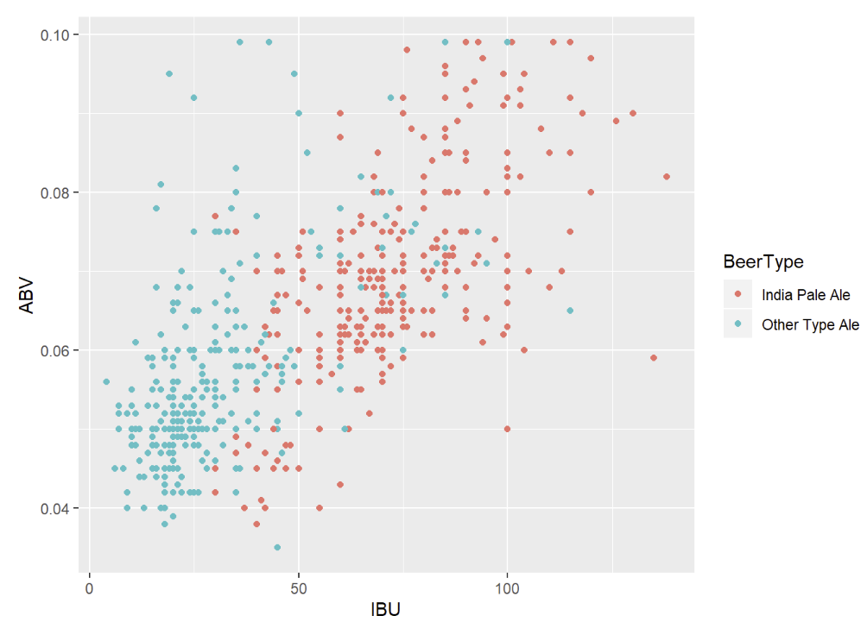
Budweiser would also like to investigate the difference with respect to IBU and ABV between IPAs (India Pale Ales) and other types of Ale (any beer with “Ale” in its name other than IPA).

Slide 10
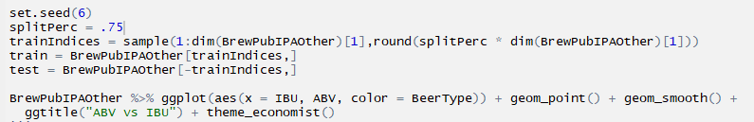
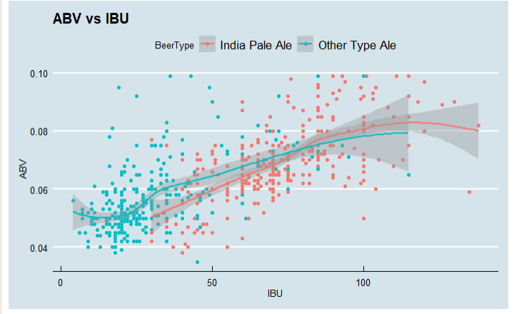
Budweiser would also like to investigate the difference with respect to IBU and ABV between IPAs (India Pale Ales) and other types of Ale (any beer with “Ale” in its name other than IPA).

Slide 11
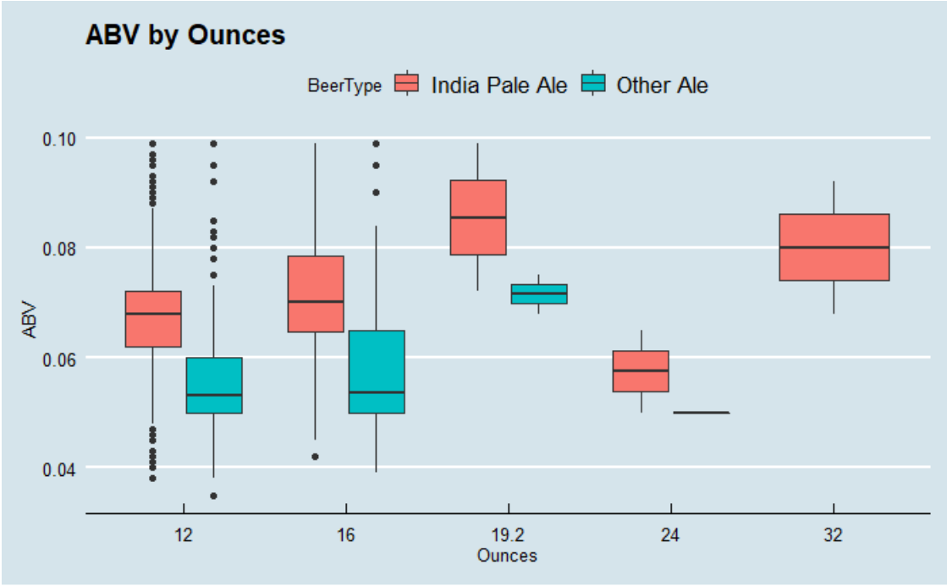
Other Insights
When looking at the beers by ounces, it appears that IPAs have higher median ABV values than other ales.

Slide 12
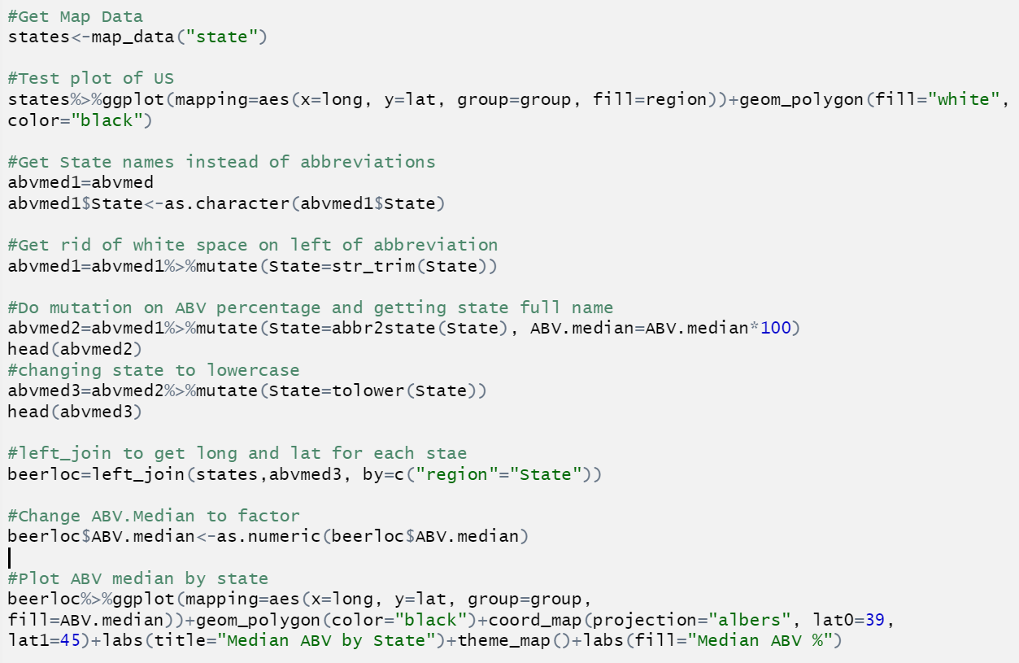
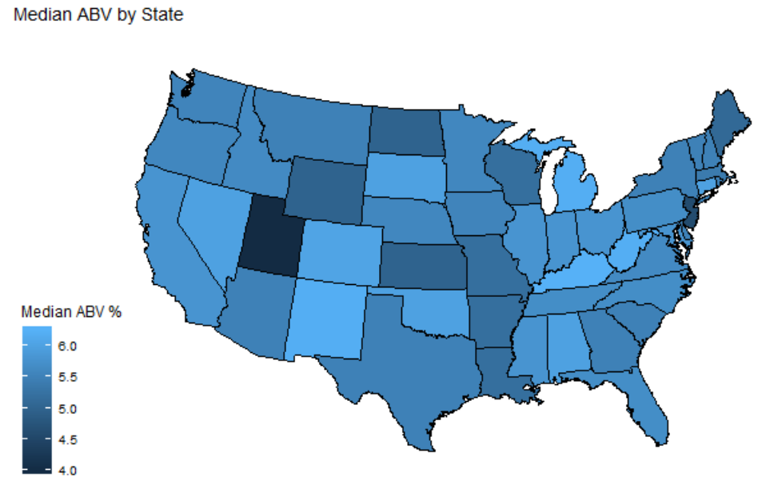
Other Insights

